Slide 1
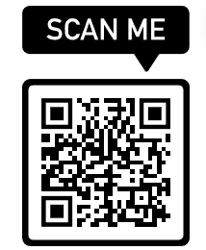


What do we know about Libraries, and their Dependencies?
April 2023 Lightning Talks
It Will Never Work in Theory

Slide 2
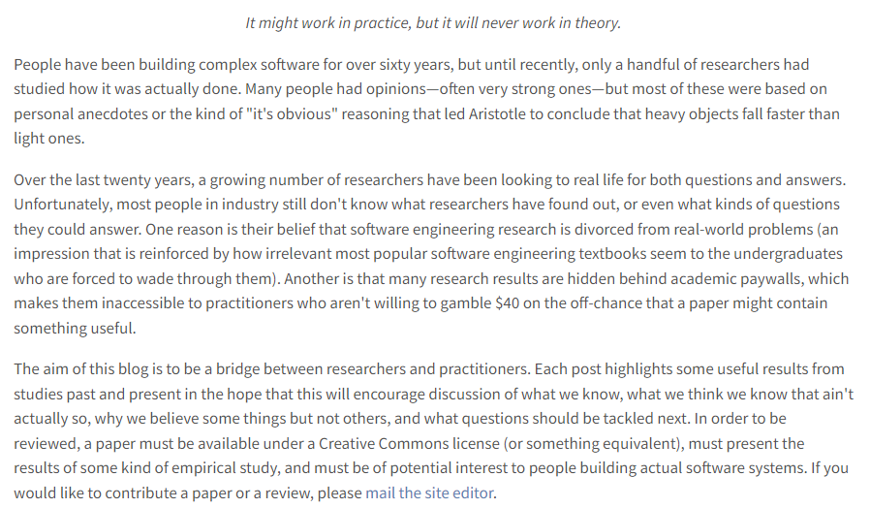
From Never Work in Theory

Slide 3

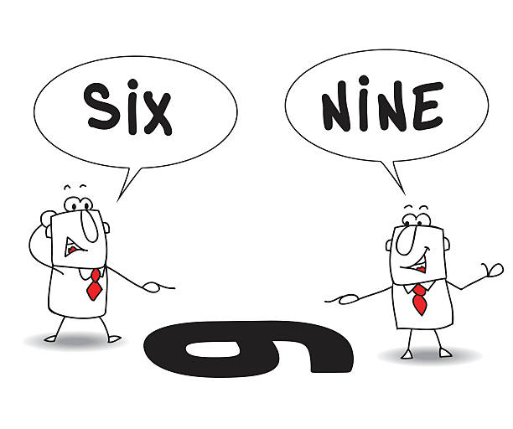
Taking a Different View!

Slide 4
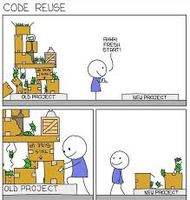
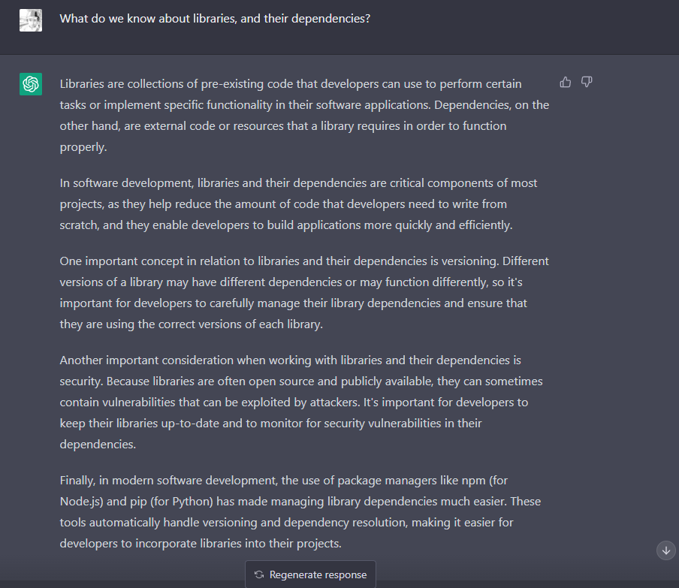

Slide 5
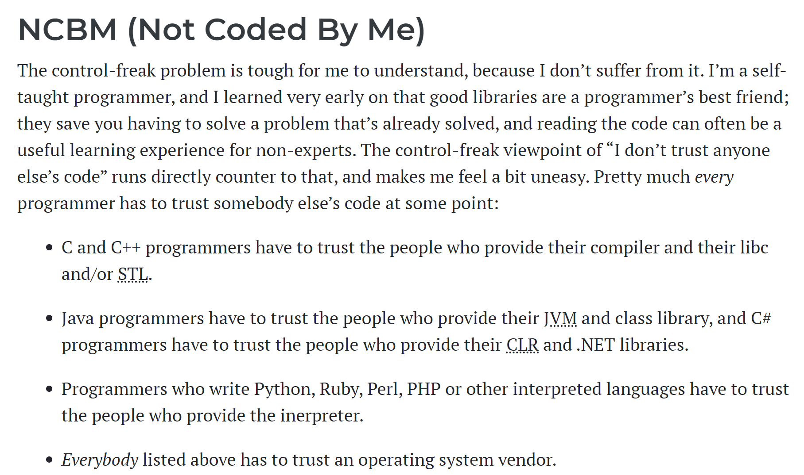
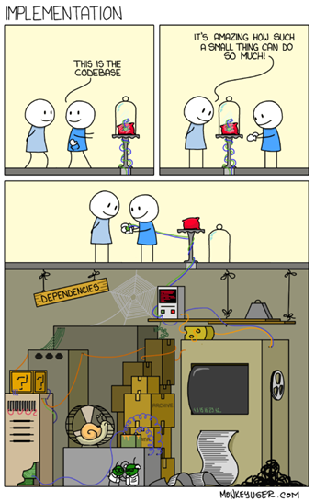
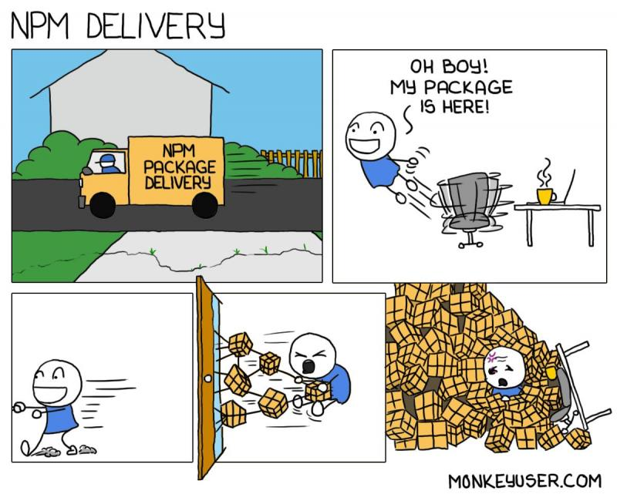
https://www.b-list.org/weblog/2007/jan/15/lets-talk-about-javascript-libraries/

Slide 6
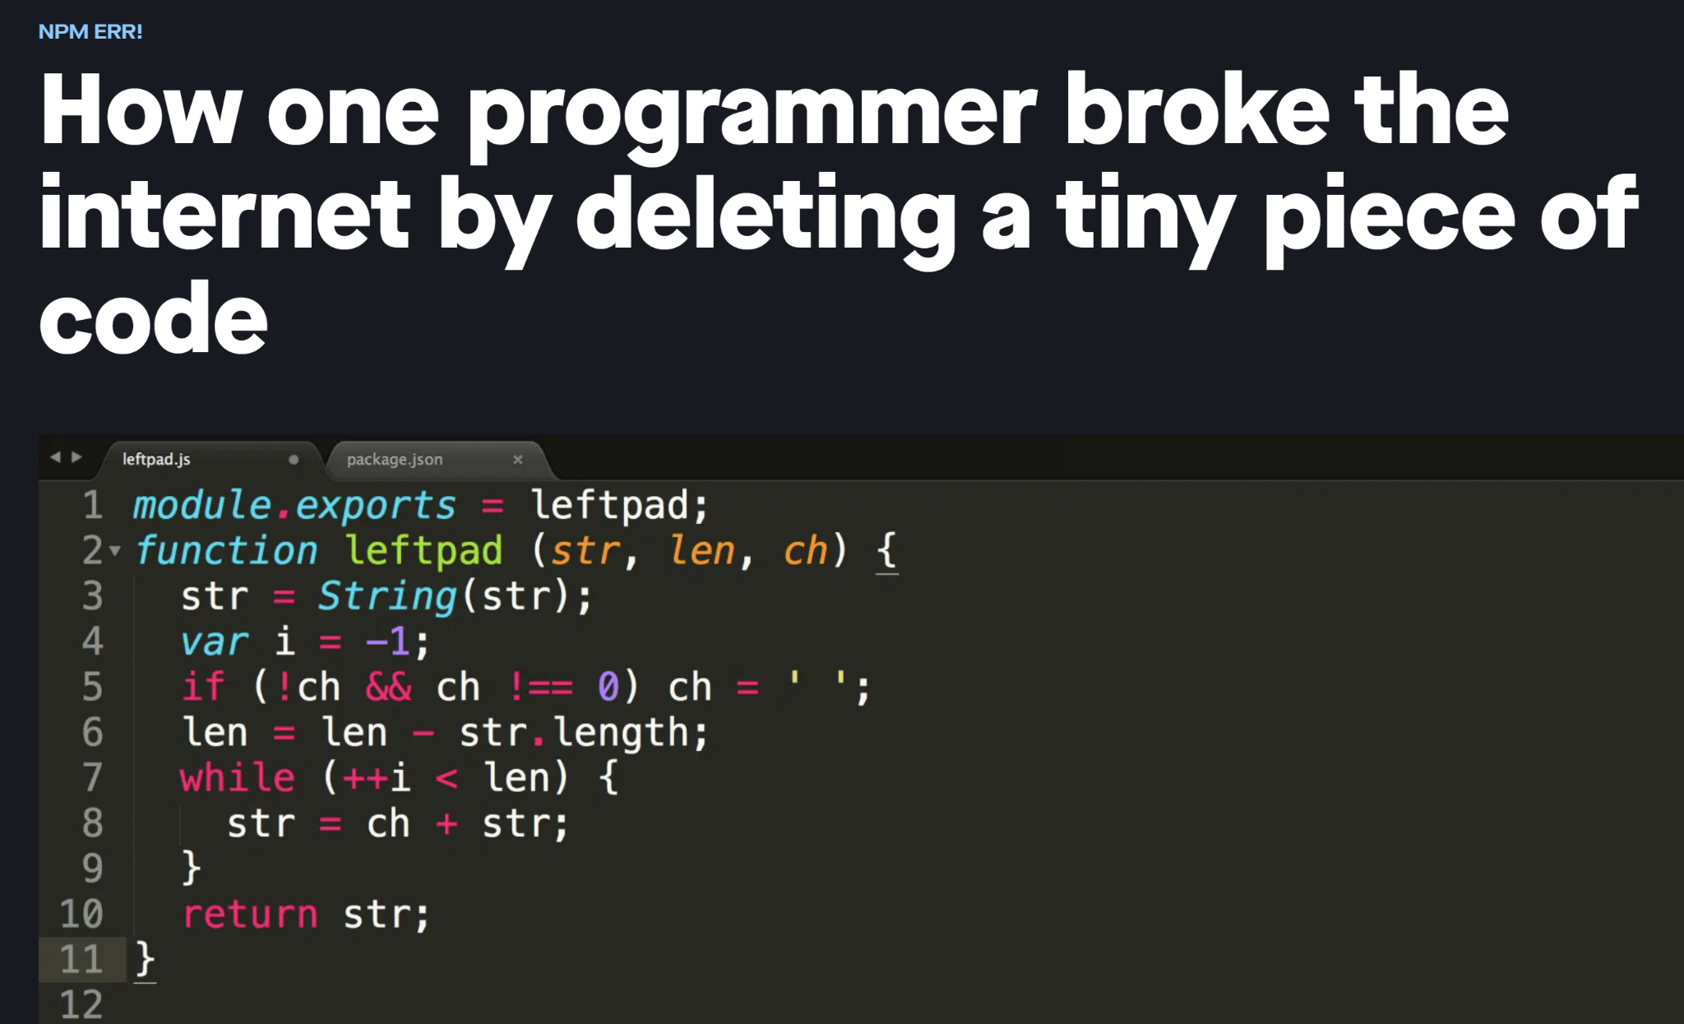
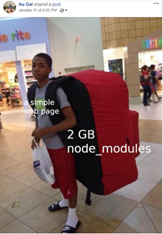
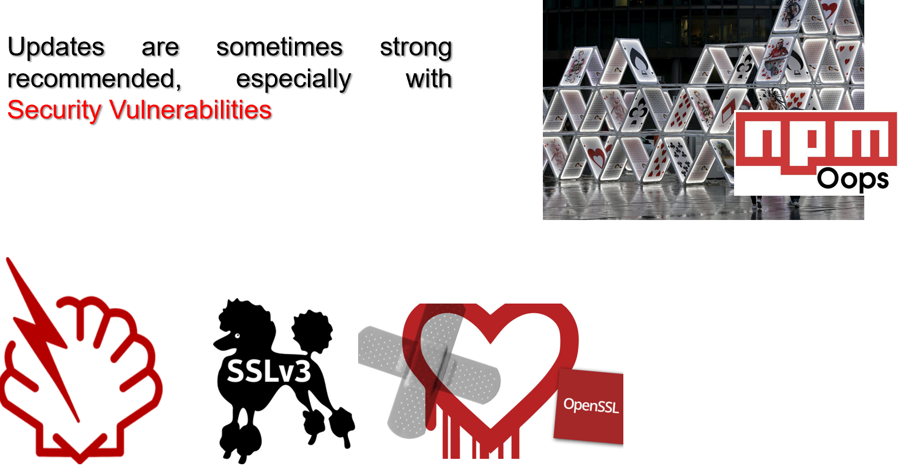

Slide 7







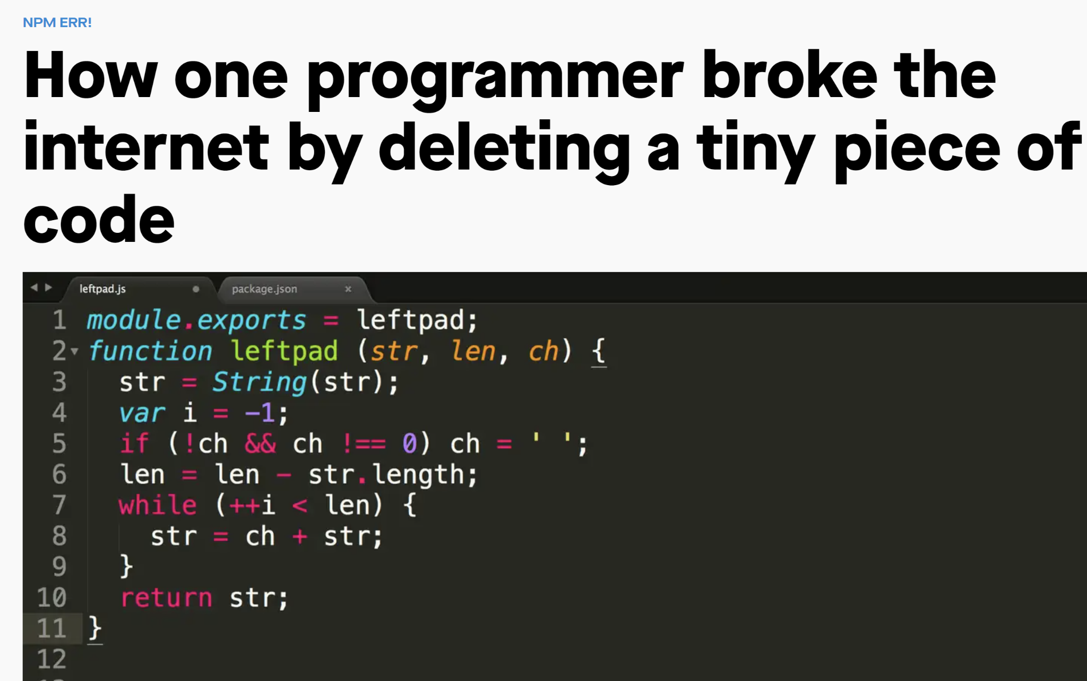

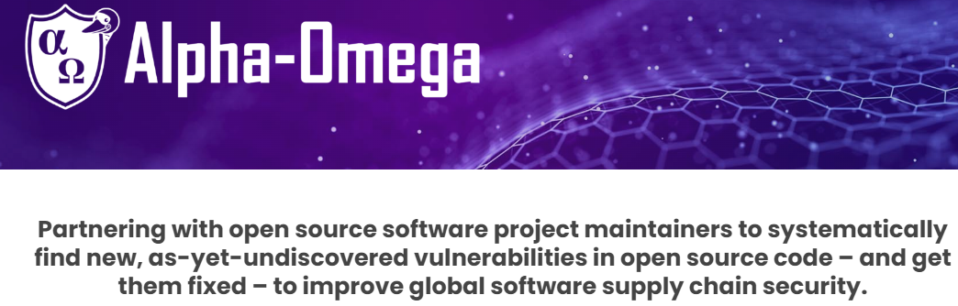



My Life so far in Research
2013
2023

Slide 8
Example 1 - Securing Libraries!

Slide 9
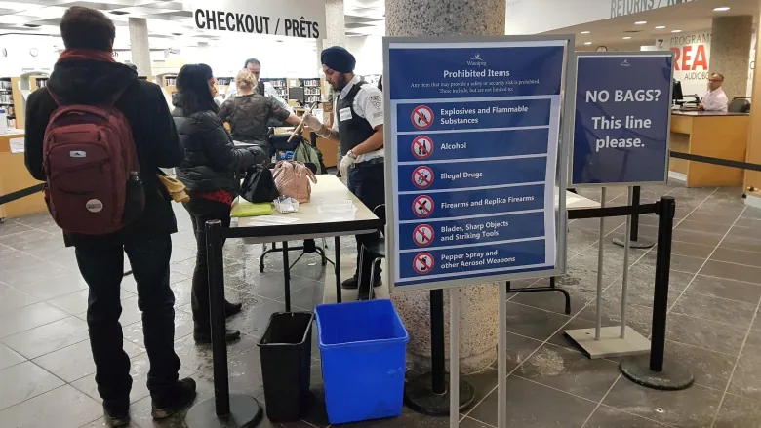
https://www.cbc.ca/news/canada/manitoba/millennium-library-security-bag-checks-metal-detectors-1.5104406

Slide 10
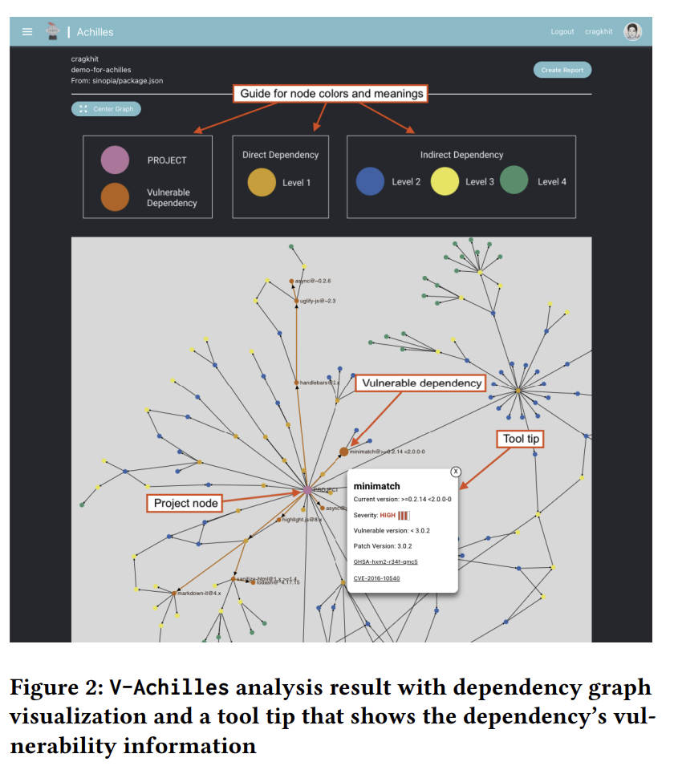

Interactive Navigation
https://v-achilles.com/

Slide 11
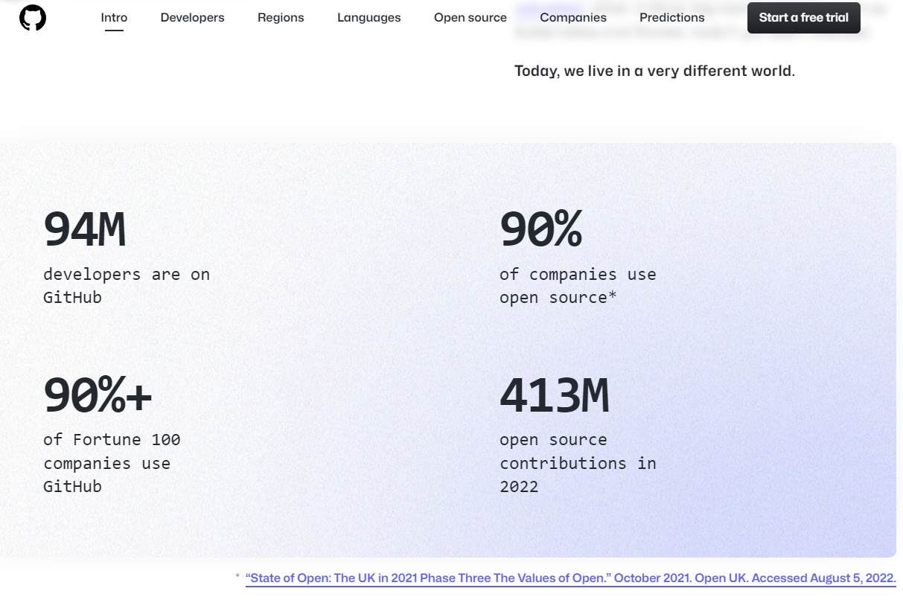

Slide 12
Example 2 - ProtestWare
Society Issues in Software

Slide 13
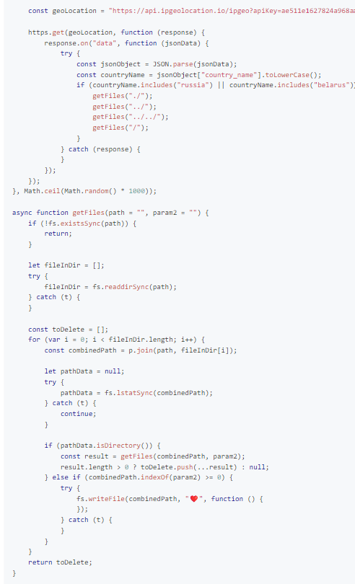
CVE-2022-23812, CWE-506

Slide 14
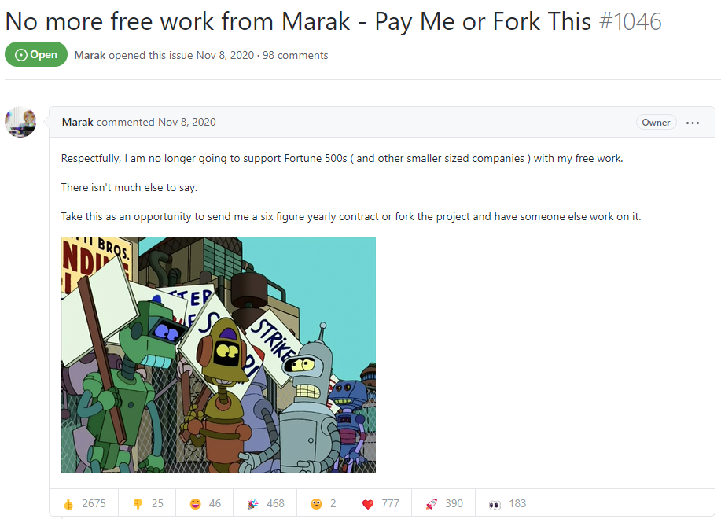
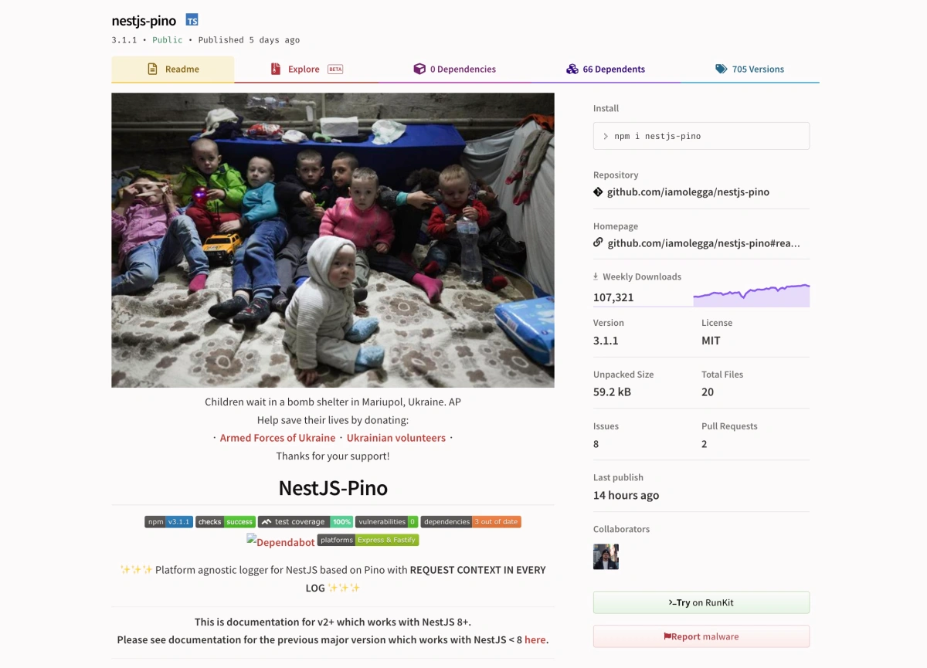

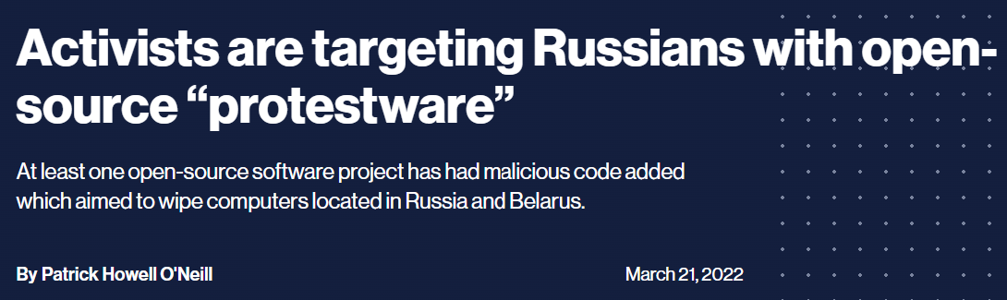
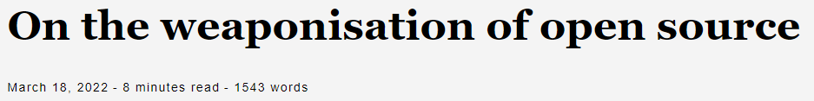
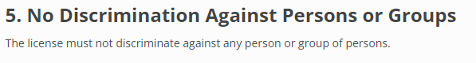
https://opensource.org/osd
https://neverworkintheory.org/2023/03/07/impact-of-world-politics-on-software-ecosystems.html

Slide 15

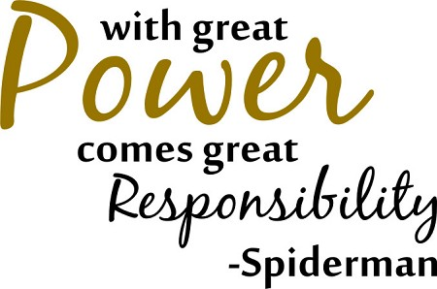
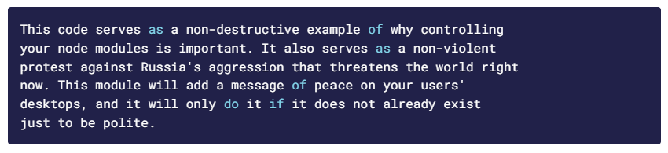
What do we know about Libraries, and their Dependencies?
Balancing Trust with Libraries.
Tools require feedback.
Gap between Open Source and Industry not so far!
Libraries are ever-expanding society.

Slide 16
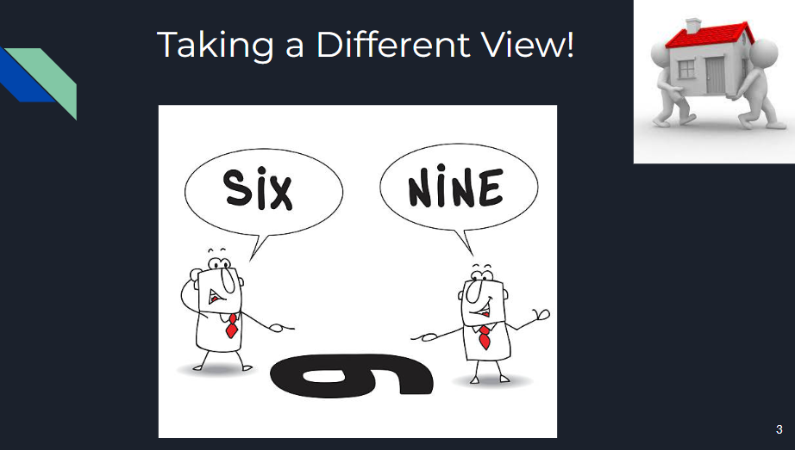
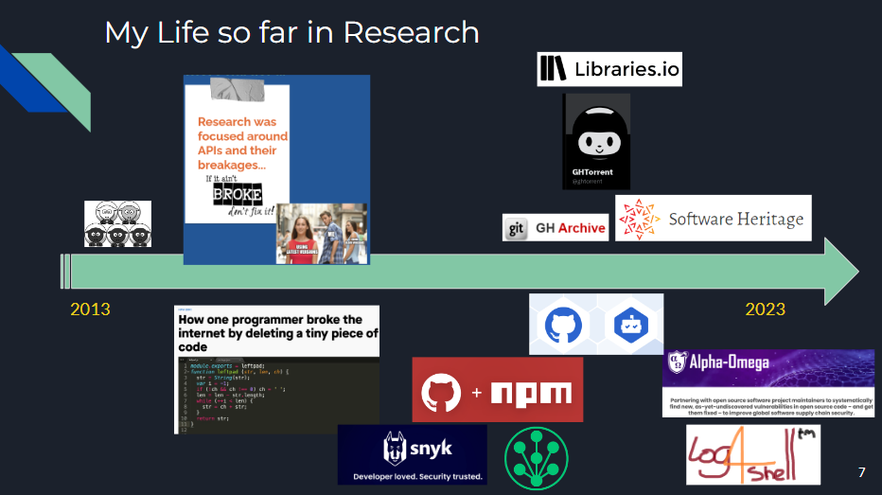
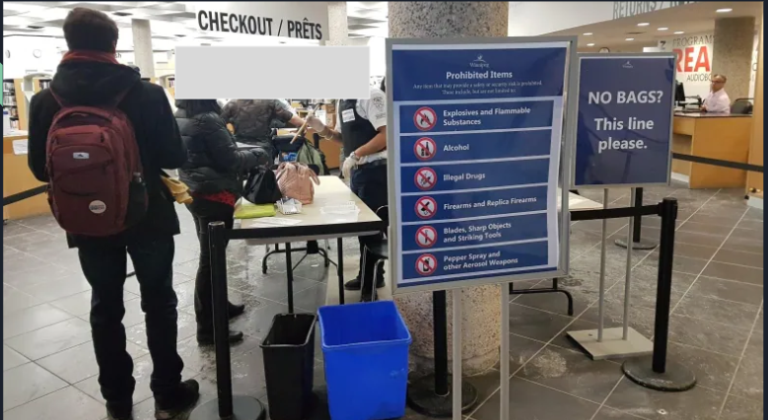
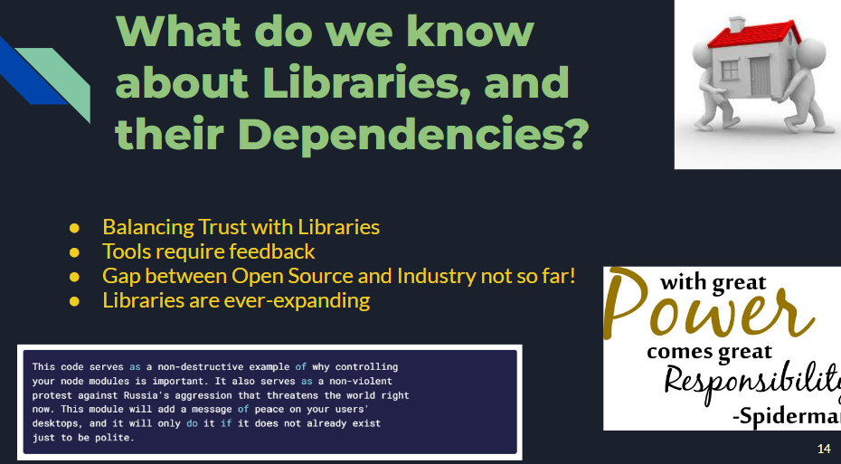
Thanks Organisers!

